Slide 1

Leadership

Slide 2
LEADERSHIP
Leadership is the ability to develop a vision that motivates others to move with a passion toward a common goal. So leadership is a process by which a person influences others to accomplish an objective and directs the organization in a way that makes it more cohesive and coherent.

Slide 3
How important is a leader?
capability
utilization
In most cases, people will perform at about 60% of their potential with no leadership at all
Thus, an additional 40% can be realized if effective leadership is available
60%
40%

Slide 4
Attributes of a Leader
Guiding vision
Passion
Integrity
Honesty
Trust
Curiosity
Risk
Dedication

Slide 5
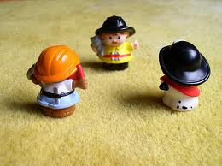
Autocratic/Authoritarian Leadership
Autocratic – The authoritarian leader makes decisions alone as power is centralized in one person. Decisions are enforced using rewards and the fear of punishment. it is an abusive, unprofessional style called “bossing people around.”

Slide 6
  Leader makes decisions without reference to anyone else
  More aggression, greater dependence on leader, more control.
  Closely supervises and controls people when they perform certain tasks.
  Worked hardest, but only when leader present
  Can create de-motivation
  May be valuable in some types of business where decisions need to be made quickly and decisively.

Slide 7
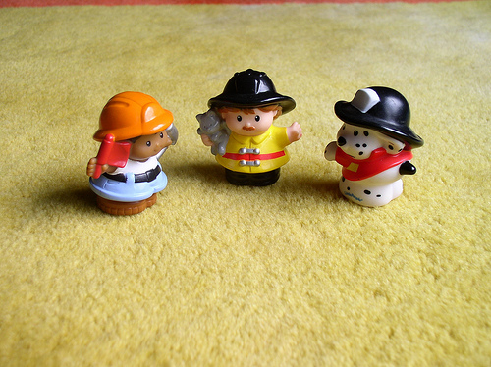
Democratic/ Participative Leadership
Democratic- The participative leader include one or more employees in the decision making process. Communication flow freely; suggestions are made in both directions. The participation encourages member commitment to the final decision.

Slide 8
Encourages decision making from different perspectives – leadership may be emphasised throughout the organisation
  Consultative: process of consultation before decisions are taken
  Persuasive: Leader takes decision and seeks to persuade others that the decision is correct
May help motivation and involvement
Workers feel ownership of the firm and its ideas
Improves the sharing of ideas and experiences within the business
Can delay decision making

Slide 9
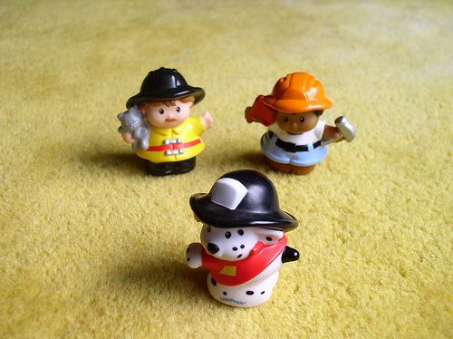
Laissez-faire/ Delegative Leadership
Laissez-faire- The leader gives power to subordinates to make the decisions. However, the leader is still responsible for the decisions that are made. This is used when employees are able to analyze the situation.
Laissez-faire is a French phrase meaning “let them do”

Slide 10
‘Let it be’ – the leadership responsibilities
are shared by all
Can be very useful in businesses where creative ideas are important
Can be highly motivational, as people have control over their working life
Can make coordination and decision making
time-consuming and lacking in overall direction
Relies on good team work
Relies on good interpersonal relations

Slide 11
Transactional leadership
Transactional leaders focus their leadership on motivating followers through a system of rewards and punishments.
Motivate by the exchange process.
  EX: business owners exchange status and wages for the work effort of the employee.
Focuses on the accomplishment of tasks & good worker relationships in exchange for desirable rewards.
Encourage leader to adapt their style and behavior to meet expectations of followers.

Slide 12
Transformational Leadership
A transformational leader is a type of person in which the leader is not limited by his or her followers' perception.
The main objective is to work to change or transform his or her followers' needs and redirect their thinking.
Charismatic and visionary
Uses rewards to positively reinforce desirable performances
Flexible and innovative.
Inspire followers to think about problems in new or different ways
Research indicates that transformational leadership is more strongly correlated with lower turnover rates, higher productivity, and higher employee satisfaction.

Slide 13
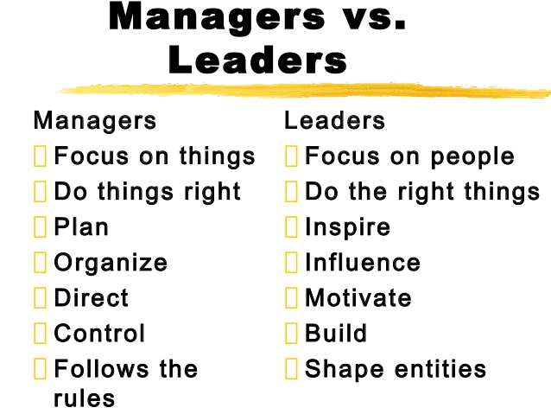
LEADER VS MANAGER

